Slide 1
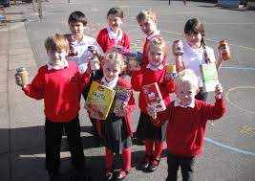
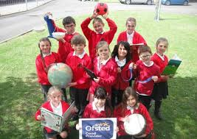

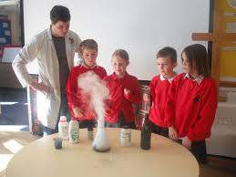
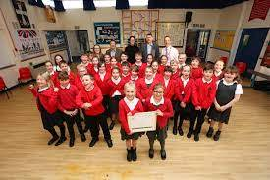
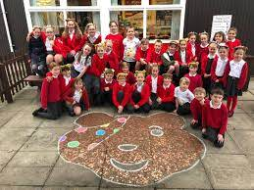

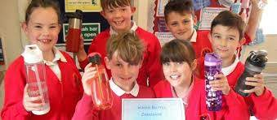
St Andrew’s Primary School
Welcome to Y4 Meet & Greet

Slide 2
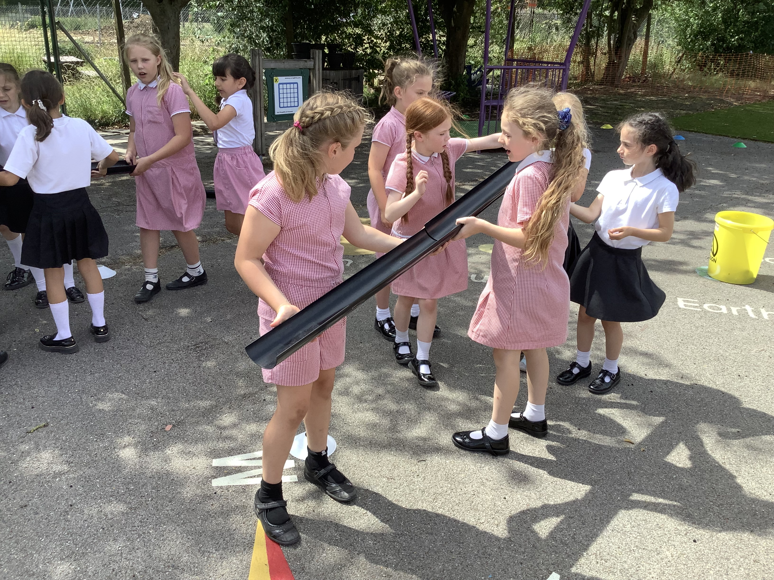
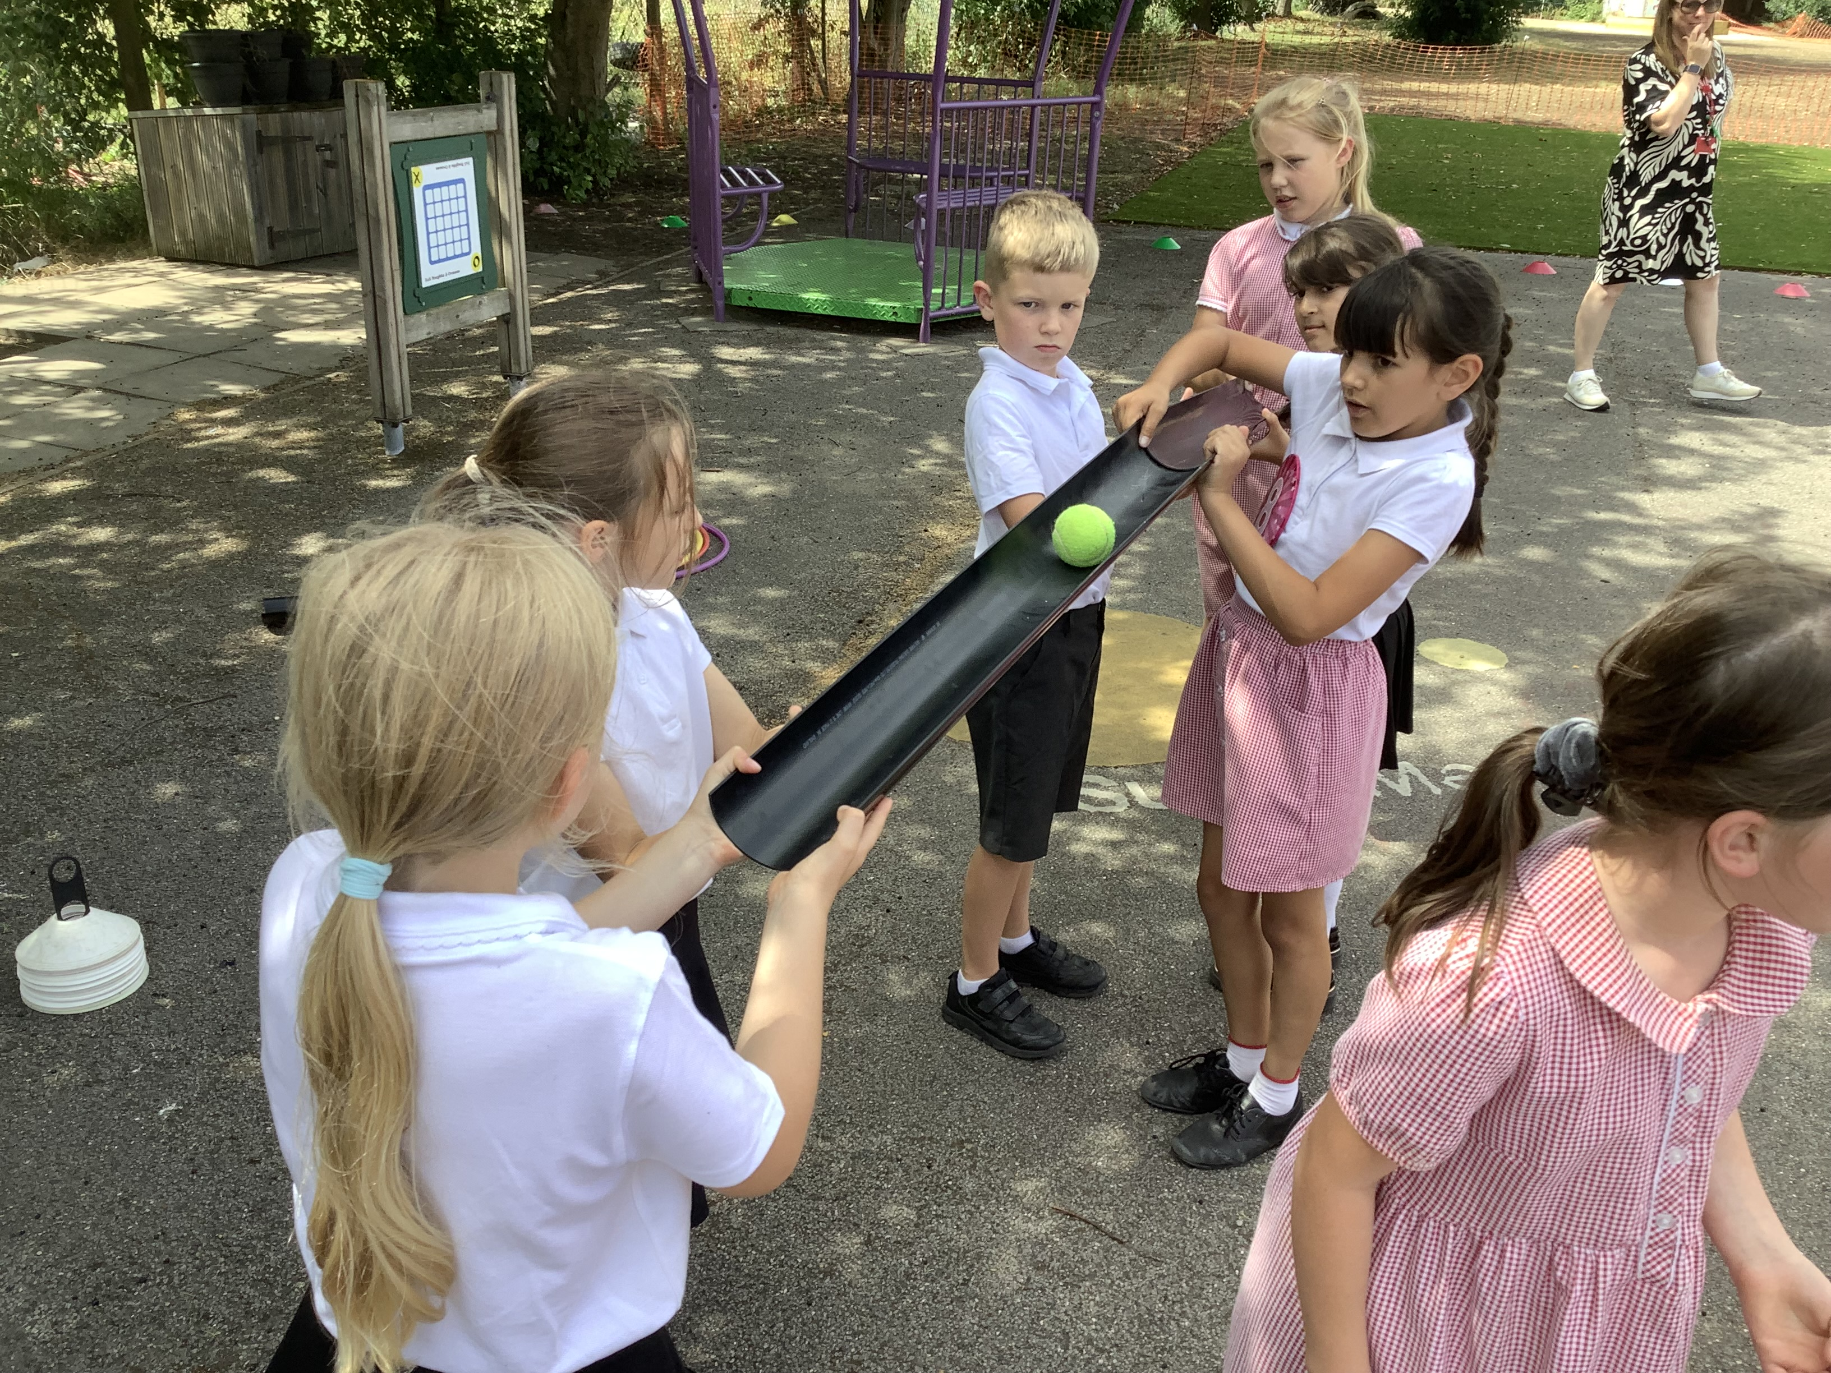
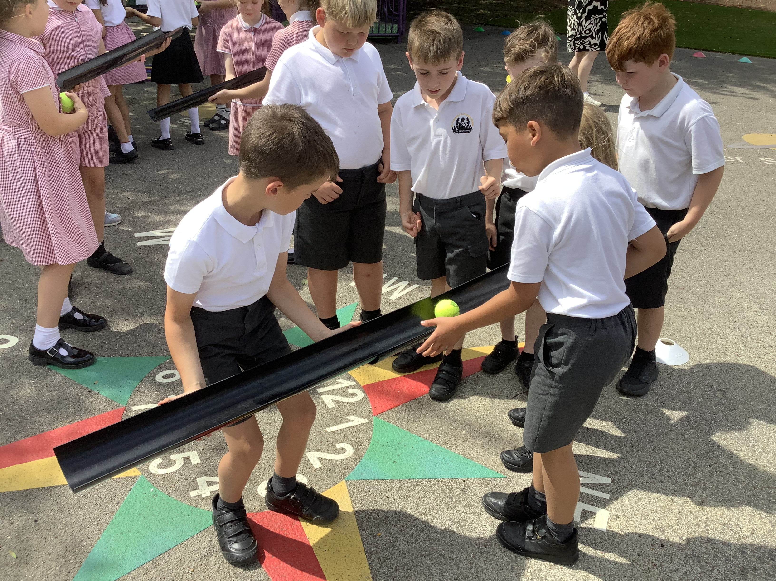
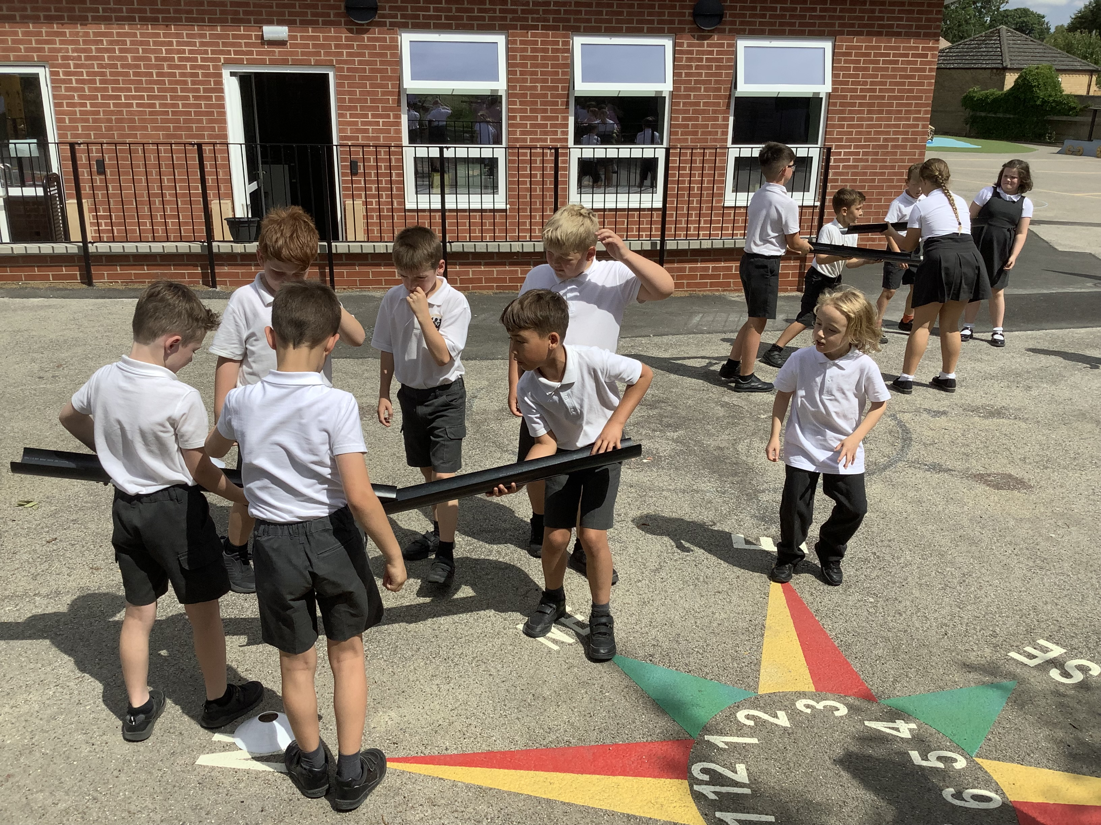
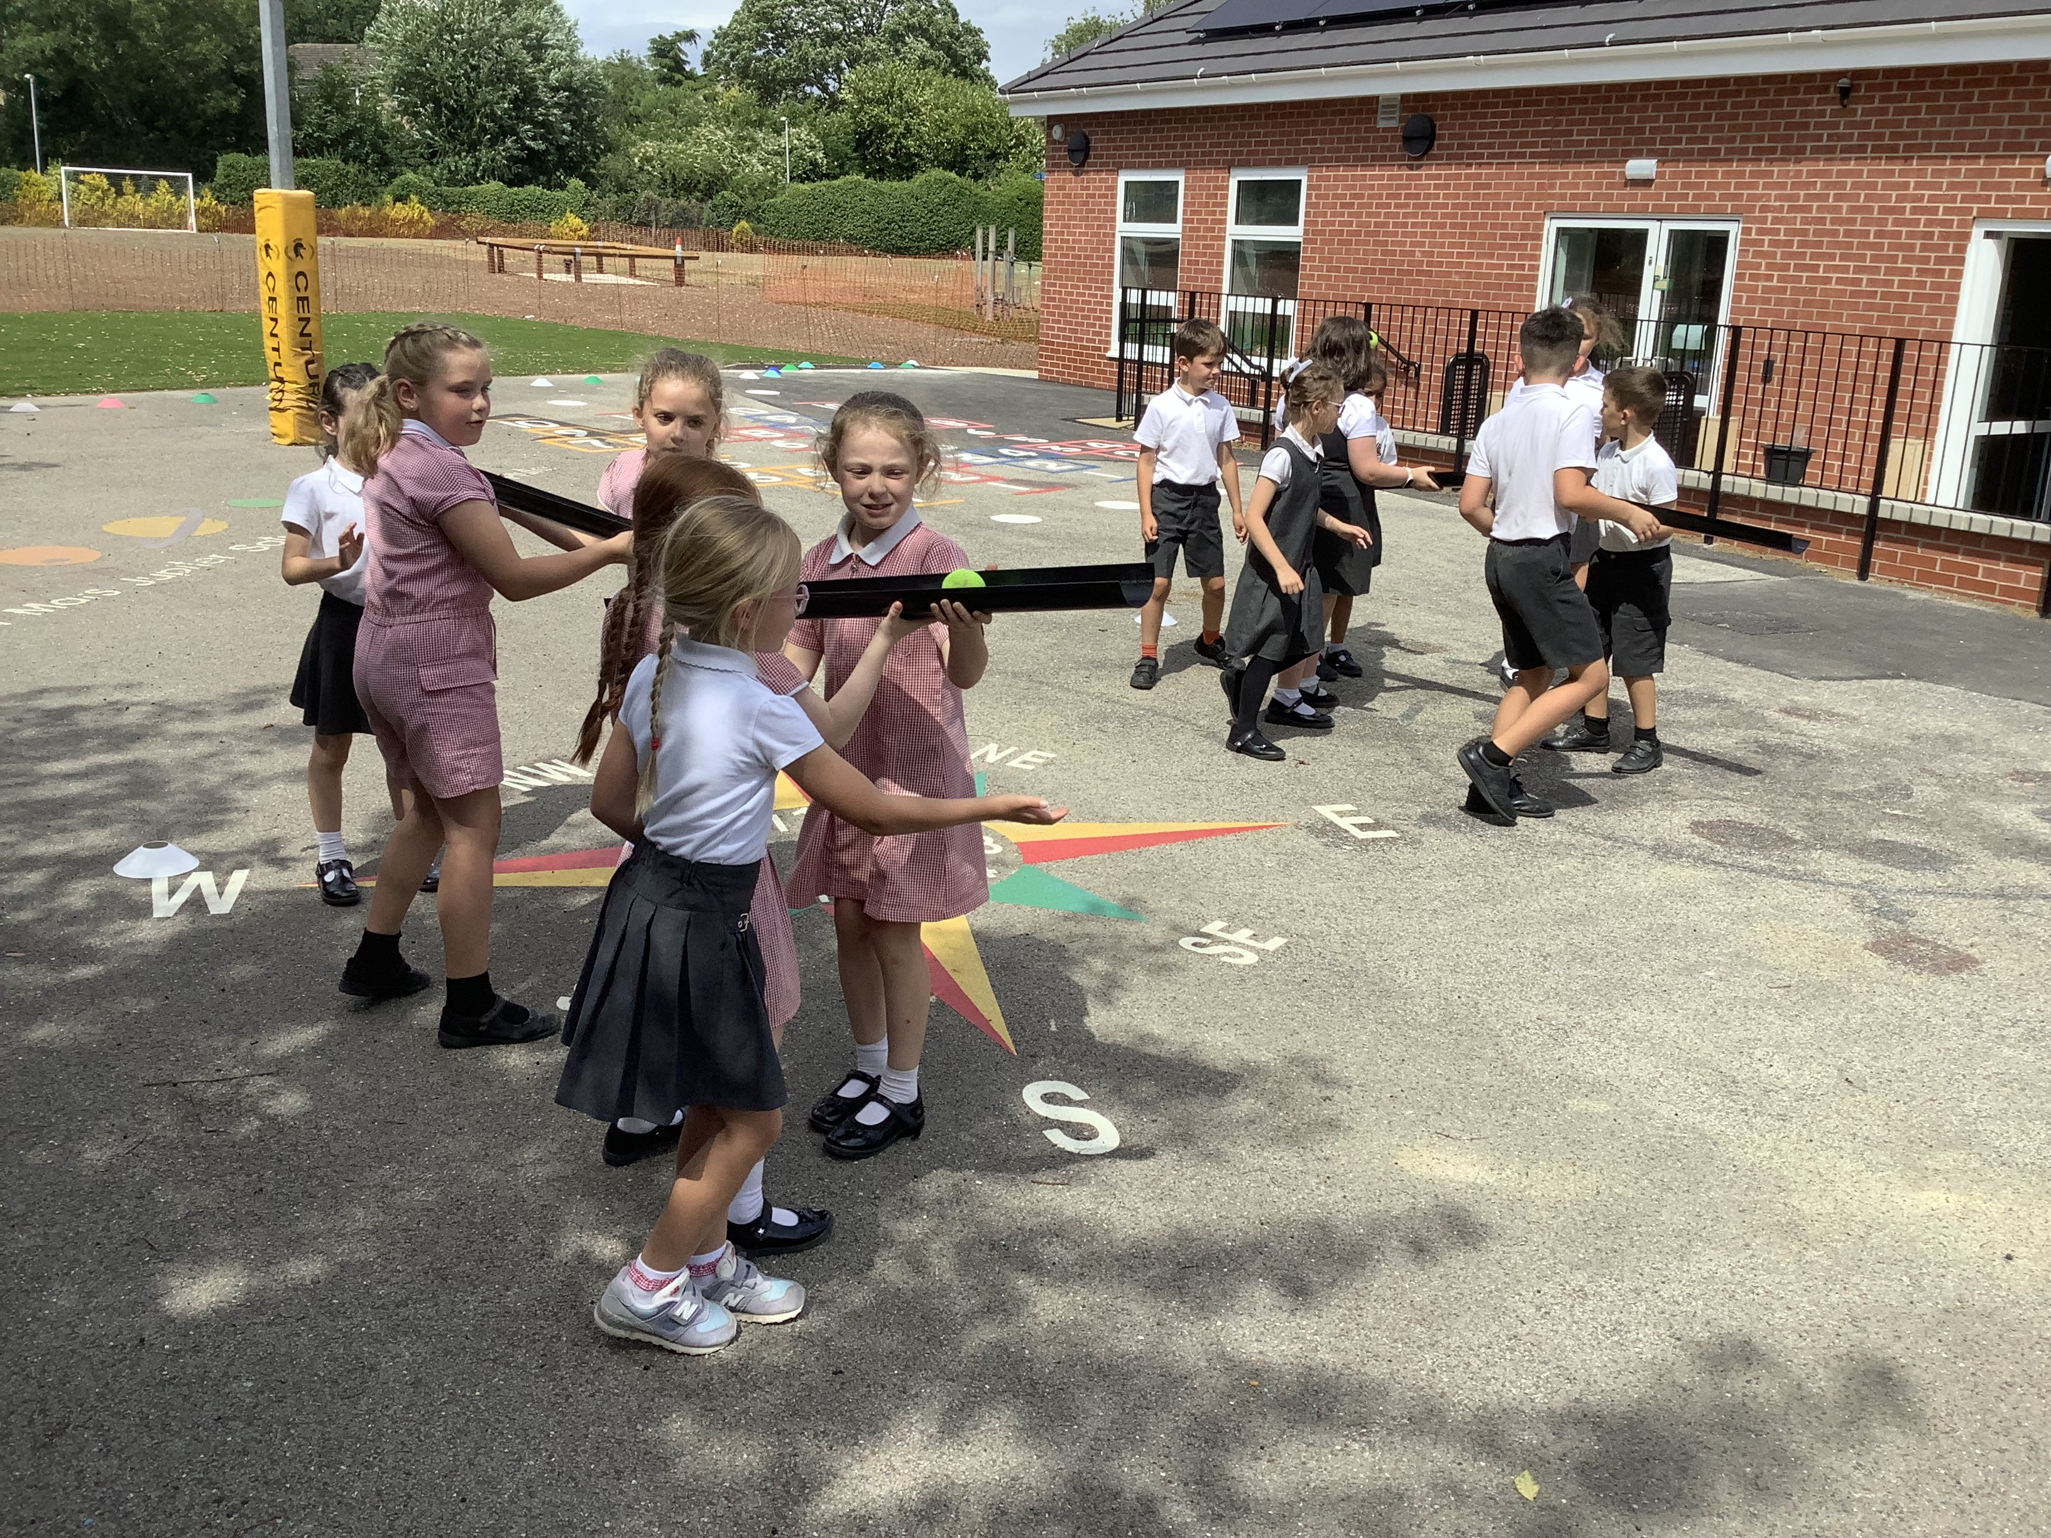

Welcome to Team Salisbury

Slide 3
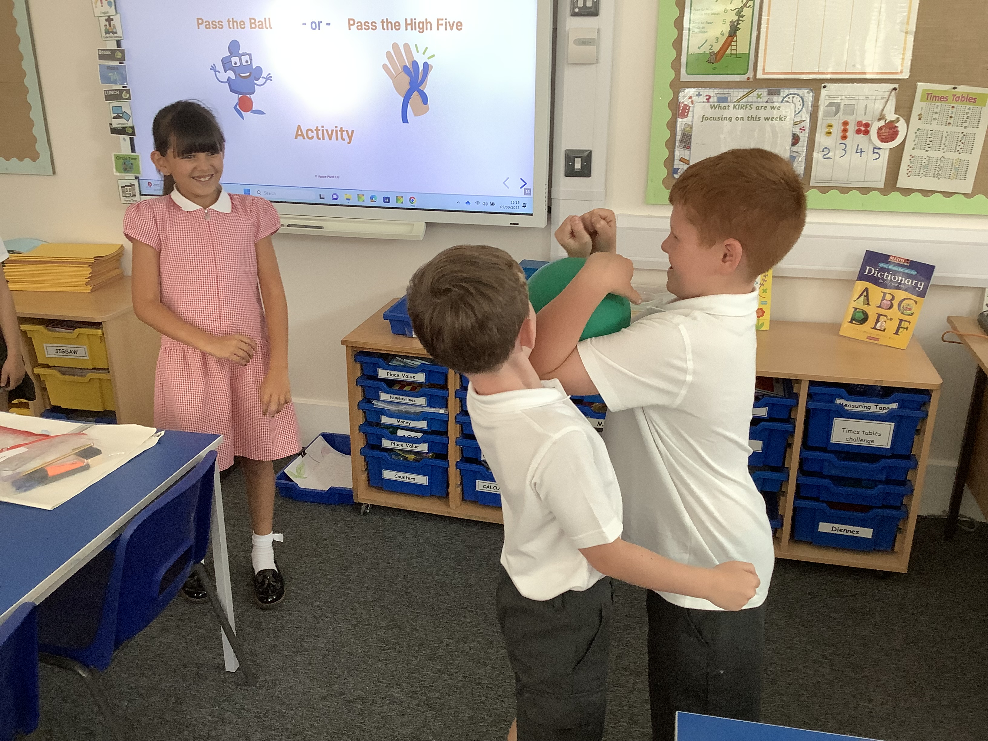
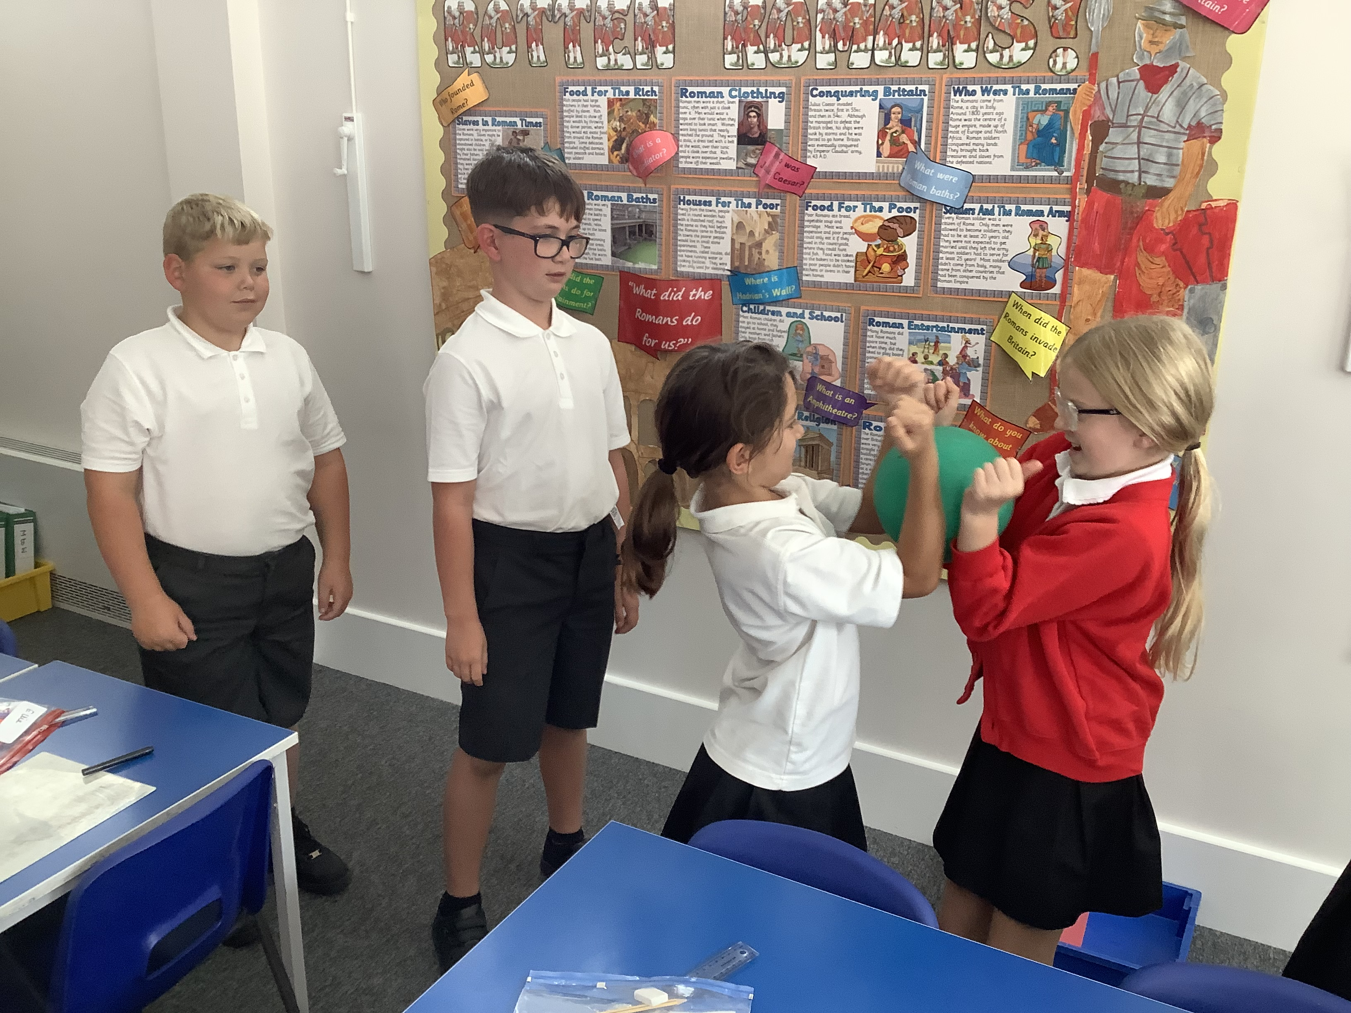
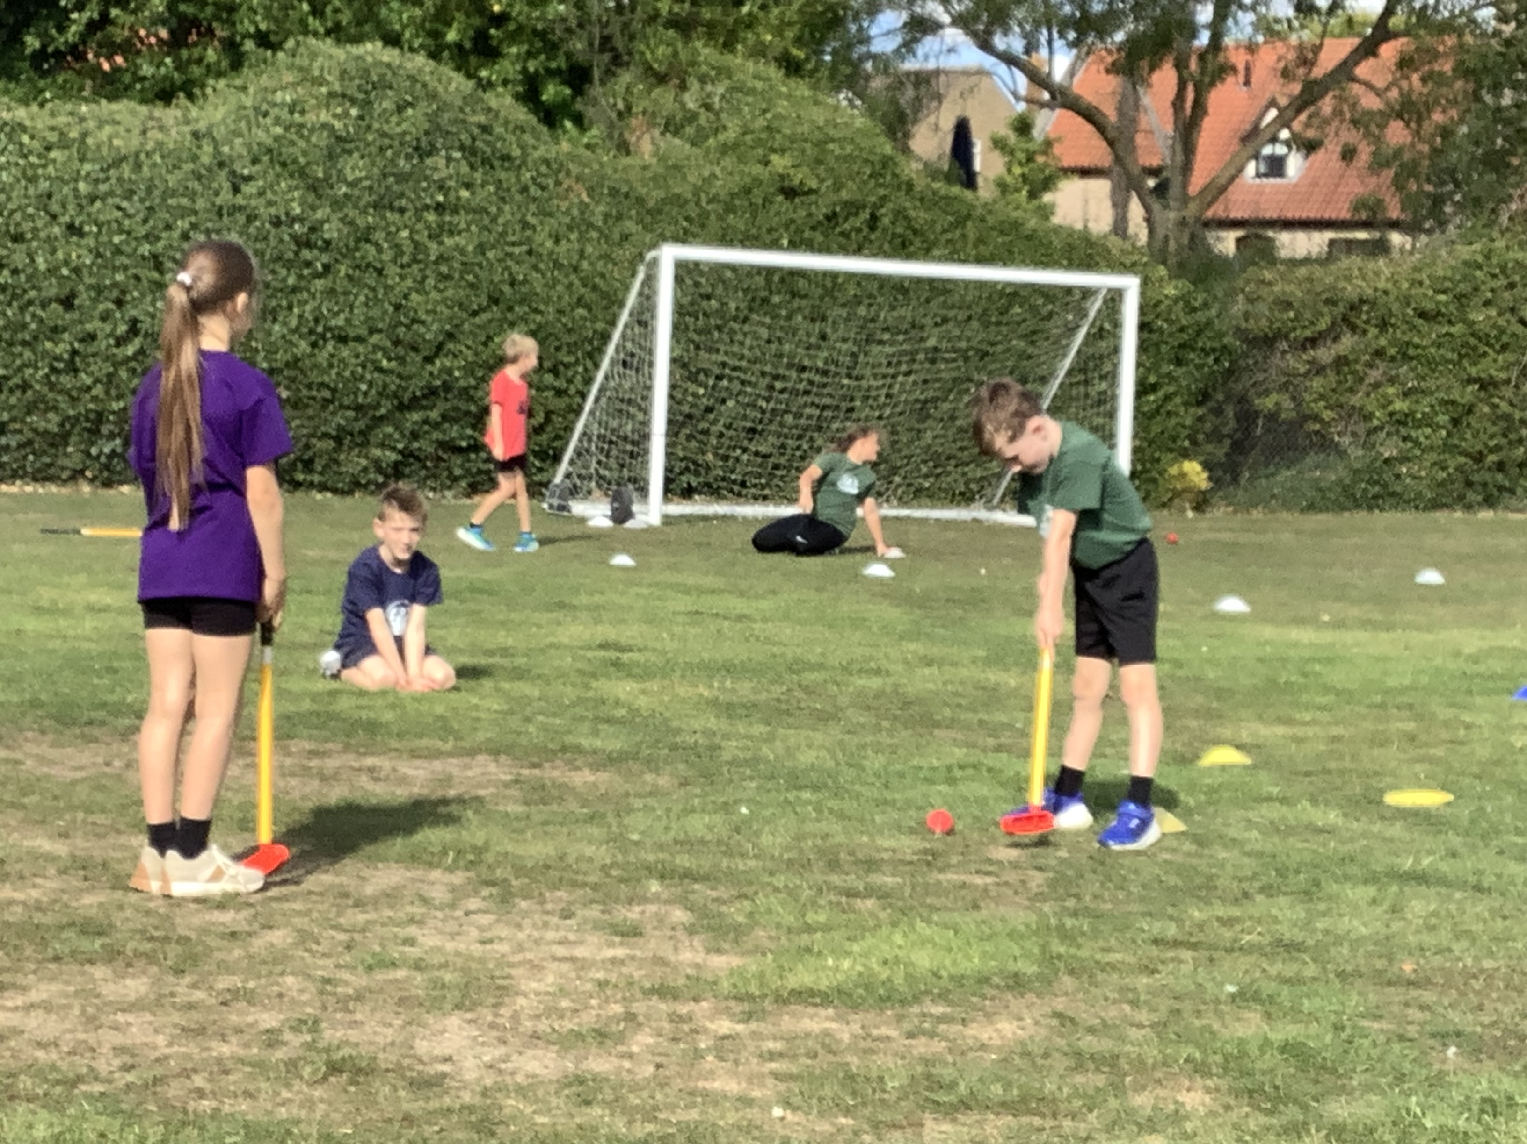
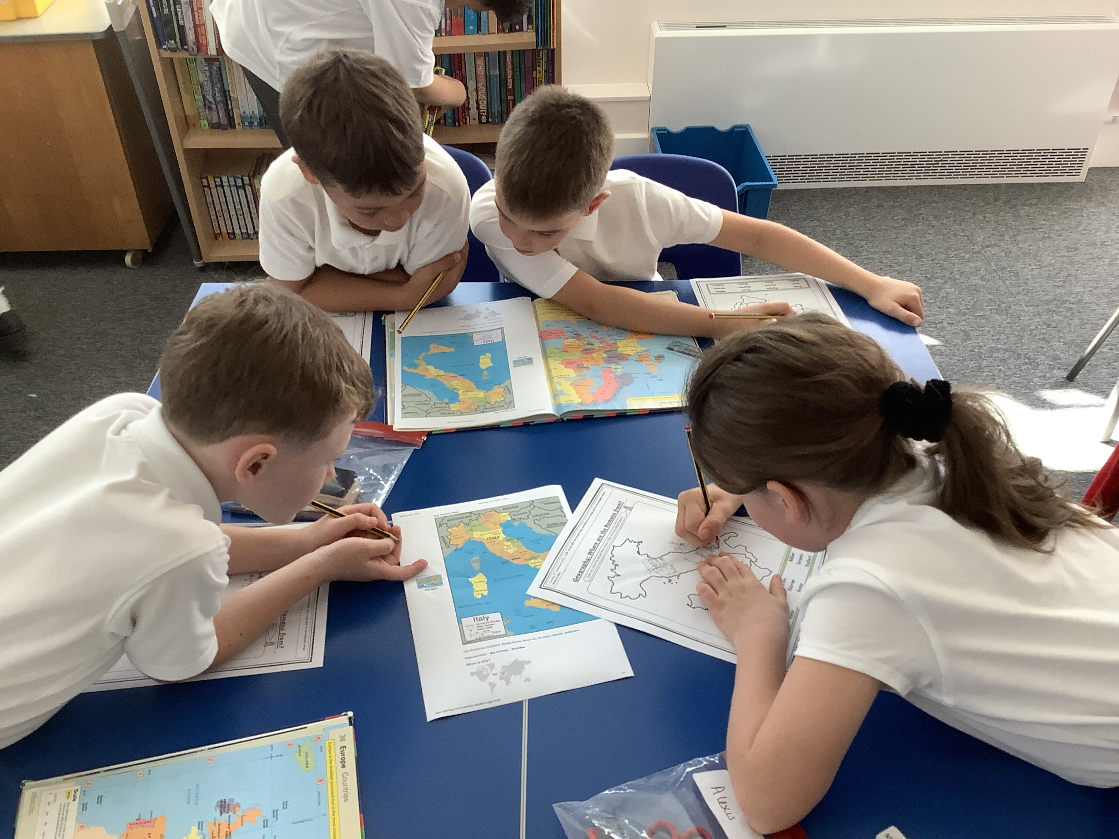
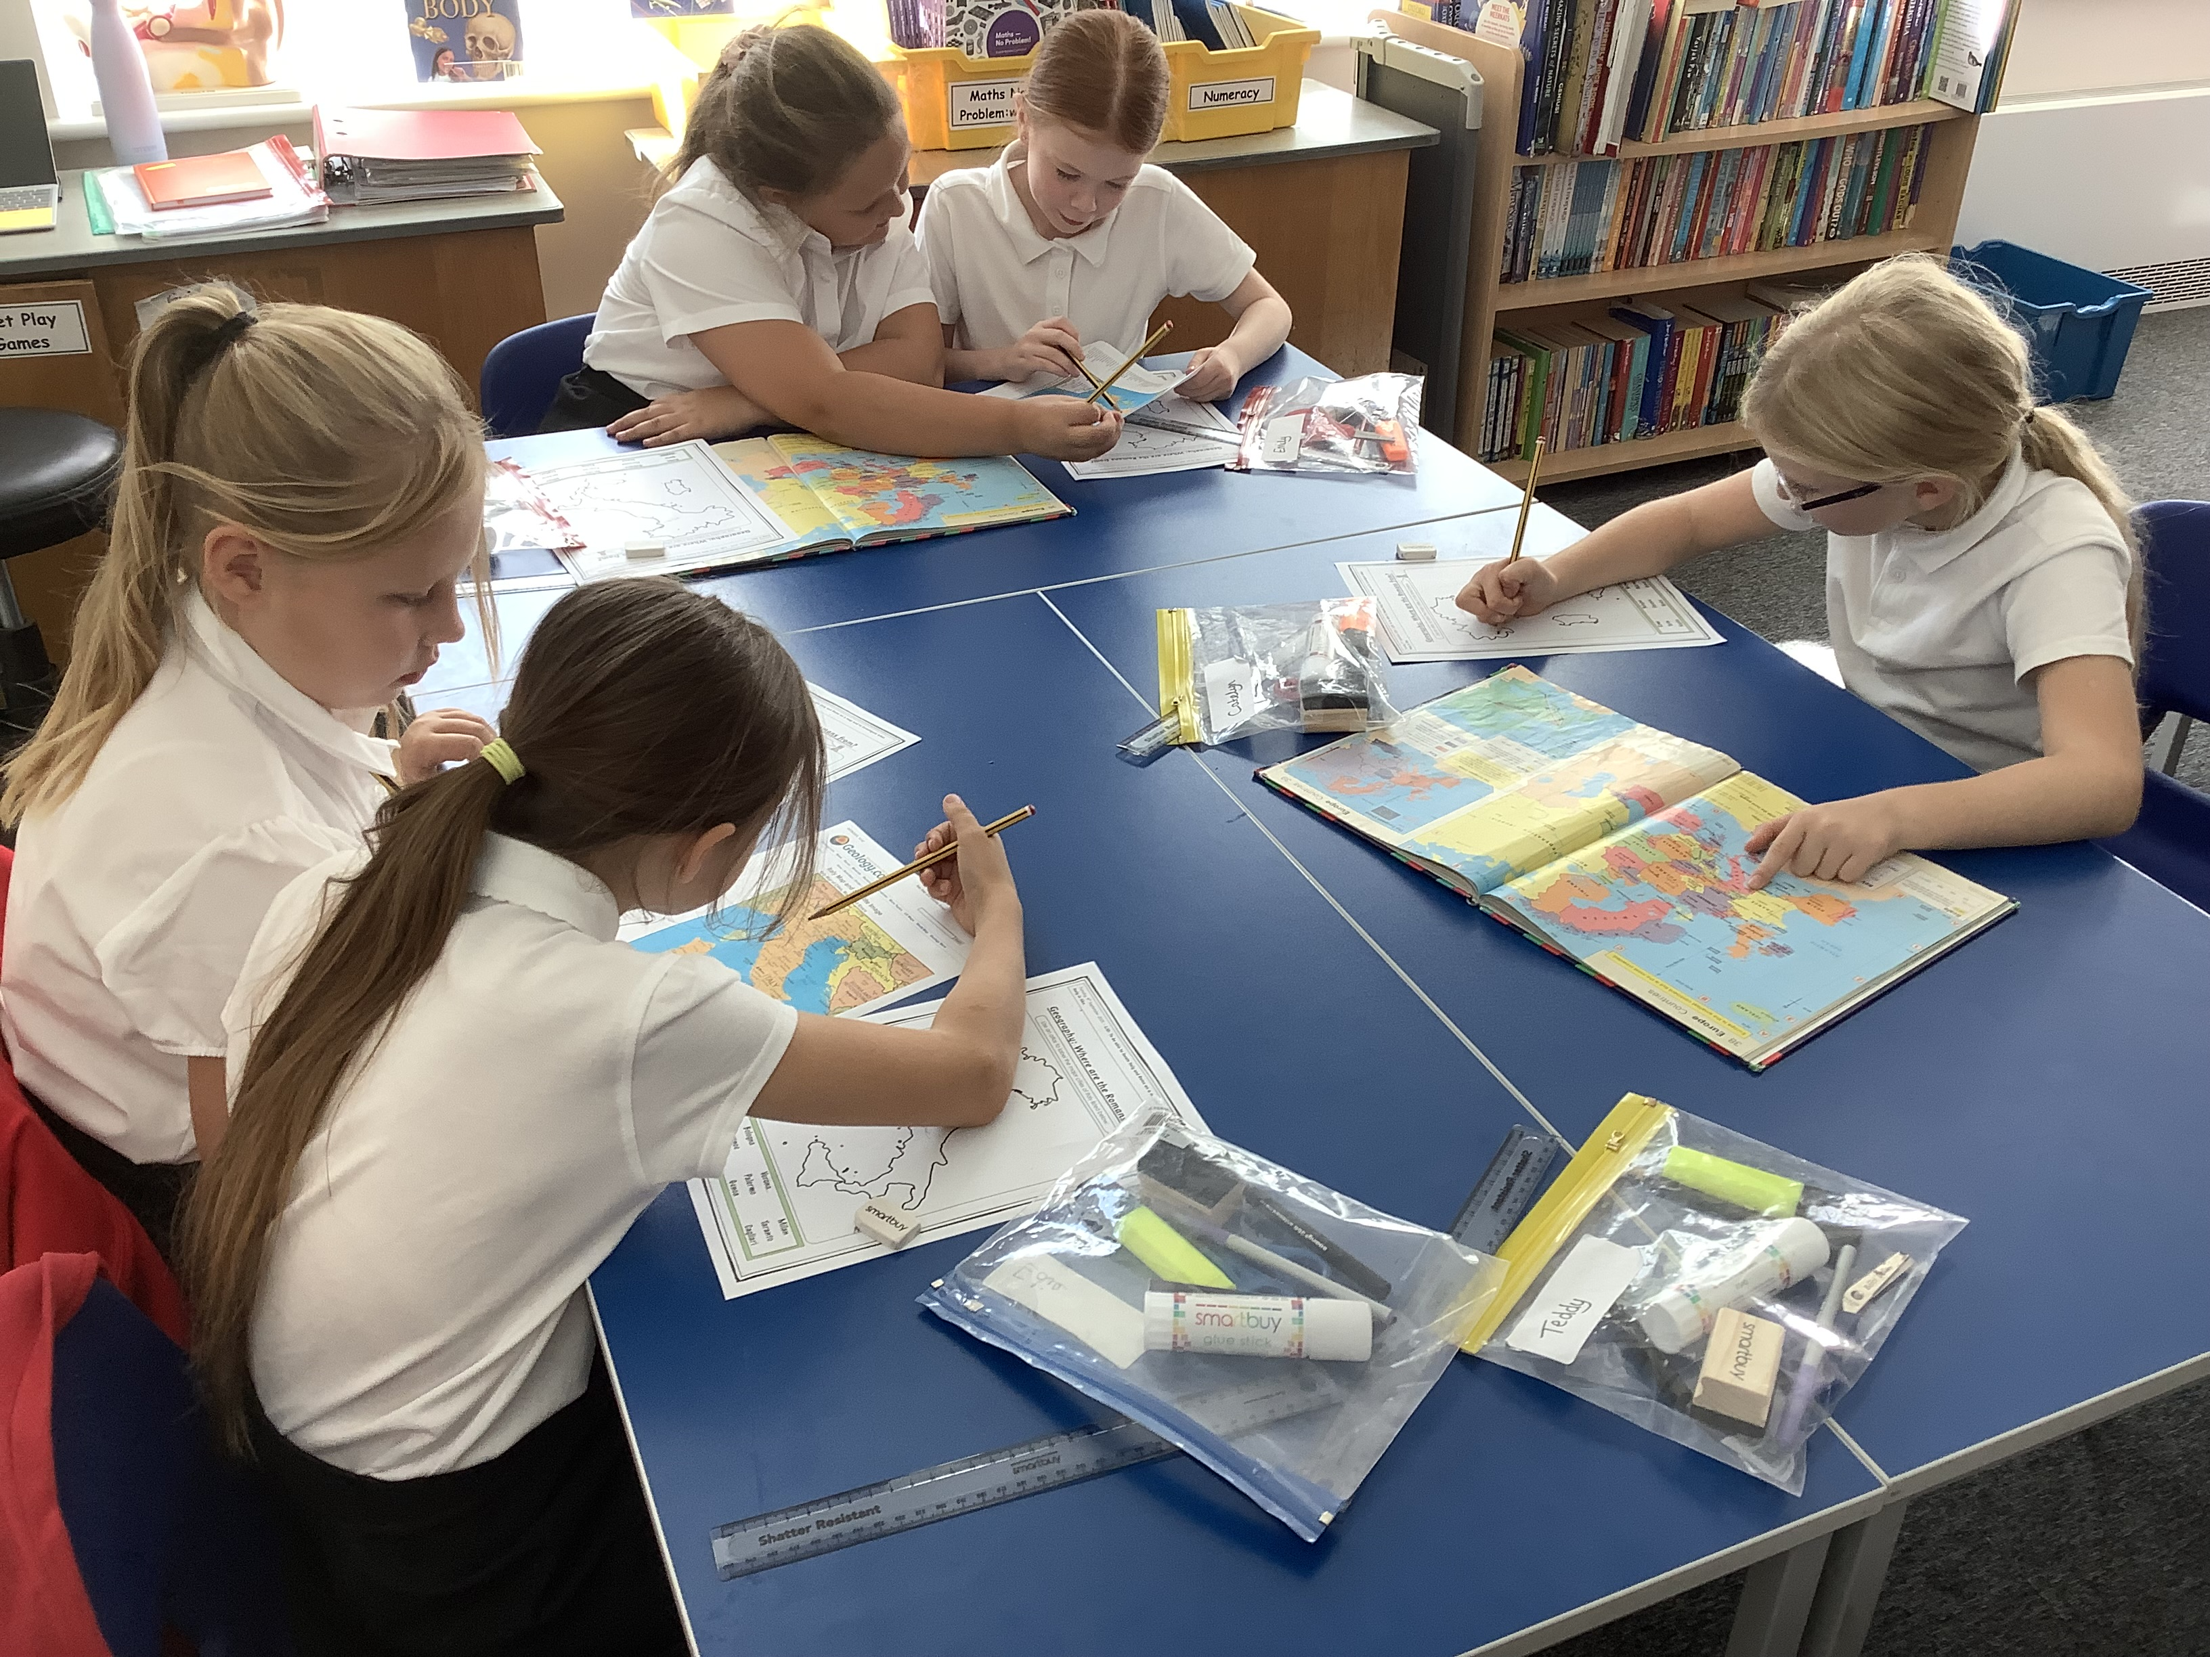
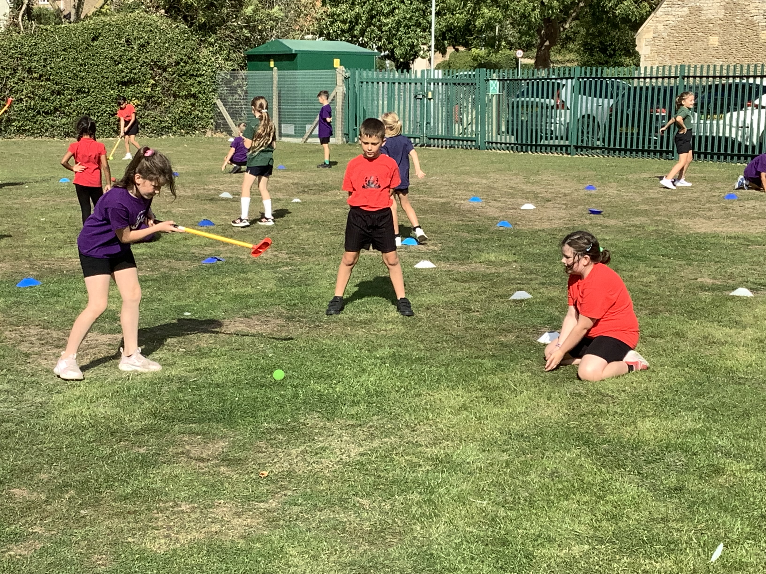

Slide 4

St Andrew’s School Vision
‘Everything you do, do in love’
At St Andrew’s, we seek to be a safe and happy environment, inspiring our school family to be positive participants in the world community. A place where we are all encouraged, through love and service, to be the very best.
Love one another, as I have loved you
John 13:34

Slide 5

St Andrew’s Golden Threads
high aspirations permeate throughout the school.
we develop a lifelong love of reading.
British Values are an intrinsic part of the school.
we offer cultural experiences and enrichment opportunities.

Slide 6

Golden Rules and Expectations
As a school community, we have high expectation of our pupils and want to ensure that they all achieve their best. Our philosophy is to encourage the positive behaviours. The golden rules are followed across school and POSITIVE reinforcement and encouragements of these rules is demonstrated in various ways, such as:
Verbal Praise
House Points
Merits
Star of the Week
Celebration Worship
Effort Cup
Responsibilities around school

Slide 7

Behaviour and Relationships Policy
We are currently finalising our new Behaviour and Relationships policy. Once approved by the governors, this will be communicated to all parents and carers.

Slide 8

Nut Free School
Please avoid sending your children into school with any food containing nuts. If you are unsure of whether food you are intending to provide contains nuts, please check with staff in the school office.
Information regarding nut allergies from the NHS can be found via the following link:
https://www.nhs.co.uk/conditions/food-allergy/

Slide 9

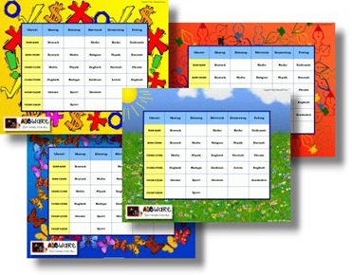
Routines
Letters (Twitter or class webpage)
Morning routine – punctuality is essential
Healthy snacks (no chocolate - Government guidelines)
Water bottles – essential and clearly labelled
Electronic Gadgets - none unless requested and protocol adhered to.
Clubs – TBC
P.E - come to school wearing kits – Monday (Term 1) / Monday & Wednesday (Term 2)
Pupil Premium – this is linked to income, if you think you might be eligible please contact Mr Baker or Mrs Allen.

Slide 10
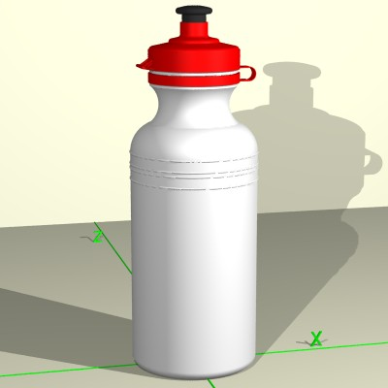
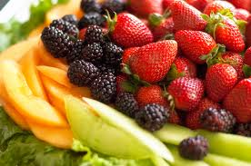

Break Time Snacks
Water Bottle
Should be a ‘Healthy’ Snack
NOT: chocolate, crisps
Due to nut allergies, please be mindful of foods that contain OR may contain nuts
Supporting Government guidelines

Slide 11
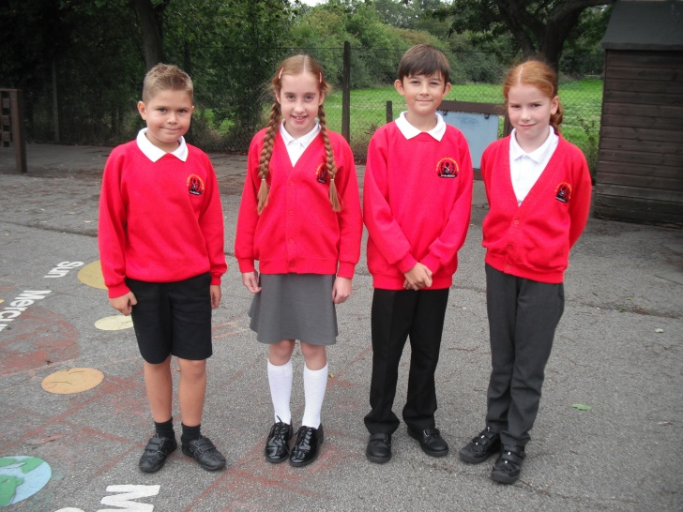
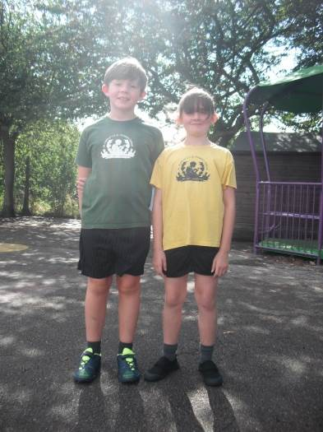
Uniform
Shirts should be tucked in.
PE Kit – should be worn to school on P.E days. This should consist of a house PE shirt and plain dark loose/soccer shorts. Not cycling shorts.
Trainers to be worn for outdoor P.E. Appropriate outdoor P.E. kit consists of school
t-shirt, a school hoodie or school jumper and tracksuit bottoms for colder weather.
Socks should be plain (white, black or grey).
Appropriate footwear must be worn.
No nail varnish and only appropriate earrings – studs.
Children with long hair should have it tied back throughout the school day with a suitable plain hair band or bobble. We would ask for no novelty hair bands or ribbons please.
Hair should be an appropriate and acceptable style for school.

Slide 12
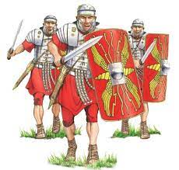
Curriculum Newsletter
Our current curriculum newsletter is available to view on our webpage. We are passionate about ensuring our children experience a broad and balanced curriculum to allow EVERY children to shine and succeed.

Slide 13

Reading
Independent – love and enjoyment of reading.
Responsibility of children to try to read every night
(read regularly each week (10/15 mins each night).
Expectation that children read at least three times
*parents can record and sign and brought in (teachers will look at these, read any parent comments but cannot respond via the book).
What can you do at home?
*School reading books, magazines, newspapers. Variety of genres.
Reading at school (guided reading weekly).
Responsibility of the children to change their own reading book. The opportunity to do this is given first thing each morning.
“Pupils should be taught to read fluently, understand extended prose, both fiction and non-fiction, and be encouraged to read for pleasure. Schools should do everything to promote wider reading … [Pupils] should be reading widely and frequently, outside as well as in school, for pleasure and information.”

Slide 14
PE
Children should come into school dressed in their PE kits on the relevant days. Please adhere to the uniform policy for correct PE kit.
Jewellery of any kind should not be worn for PE. This includes watches.
Children with earrings must be able to remove these themselves before taking part in PE lessons.
Children with long hair should tie this away from their face, using a soft band/hair bobble. Grips, bows or plastic clips should not be used for this purpose.

Slide 15




Homework
Below are guidelines of what could possibly be set for homework.
Further details of our homework is available on our school webpage/twitter.
Homework diary - signed and brought in (teachers will look at these, read any parent comments but cannot respond via the book).
Not every section in the diary will be completed each week
Homework could be a mixture of any of the following: spellings, a topic related task, TT Rockstars or other online resources.
This will be set on a Thursday and should be COMPLETED by Tuesday unless stated otherwise.

Slide 16
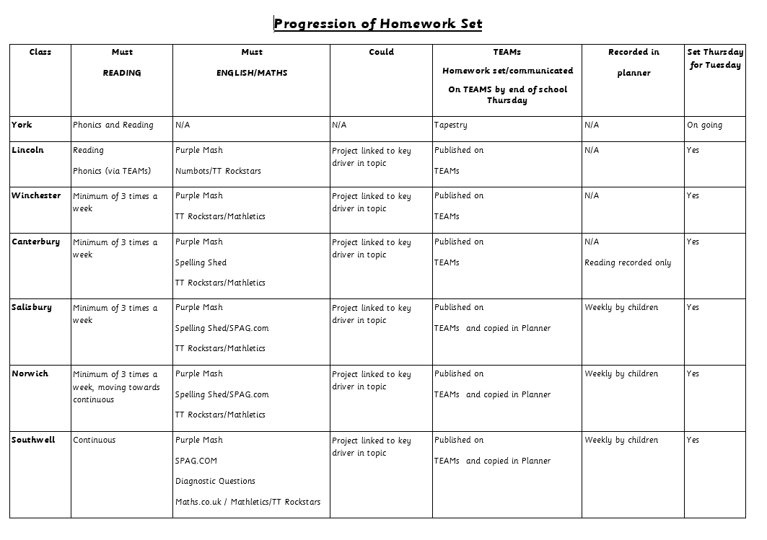

Slide 17
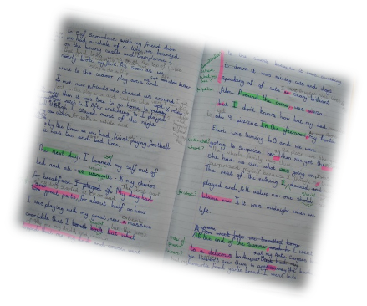
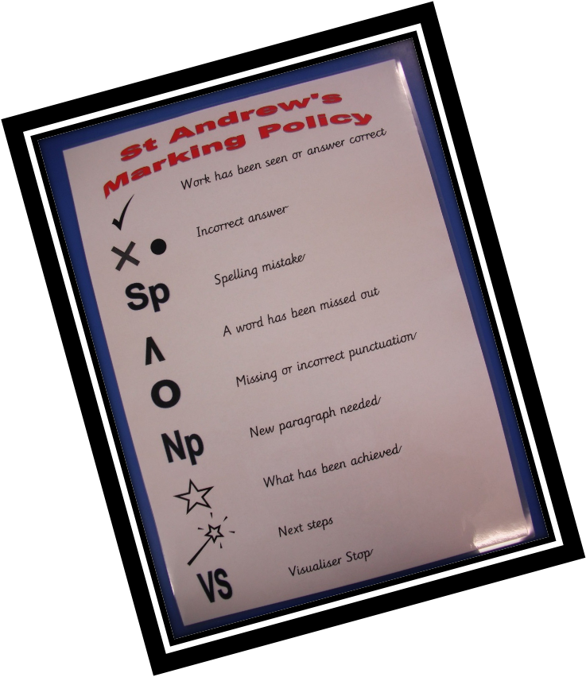
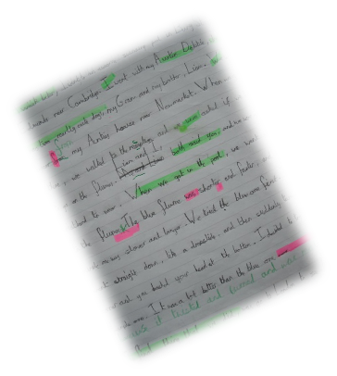
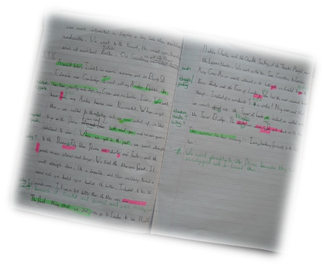

Marking Policy

Slide 18
Communication
Please use the TEAMS platform as the children’s way to communicate regarding their homework.
All other communication should be sent via the ‘enquiries’ email address:
enquiries@st-andrews.lincs.sch.uk
Website: www.st-andrews.lincs.sch.uk
Twitter/X: @LeasStAndrews
Class Twitter/X:

Slide 19
The school uses ARBOR for the following:
Parent Evenings
Trips
Text around will also give you updates around school.
Please could you ensure that all current details we have for you are up-to-date.
If you have any issues, please contact Miss Flemming.

Slide 20





Internet Safety
We would like to make you aware of the issues we’ve had in the past and needed to deal with in school regarding the inappropriate use of technology and Social Media from out of school. This also applies to some games that have 18 ratings yet children in school are playing these. These games contain inappropriate material that is repeated by the children in school and has an impact on their behaviours.
APP | Appropriate Age to Access
Whatsapp | 13
Snapchat | 13
Skype | 13
Instagram | 13
TikTok | 13

Slide 21
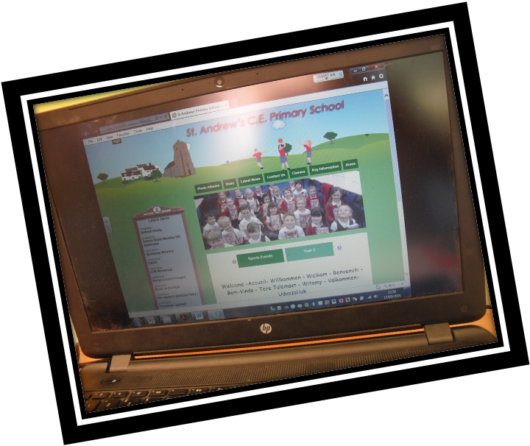
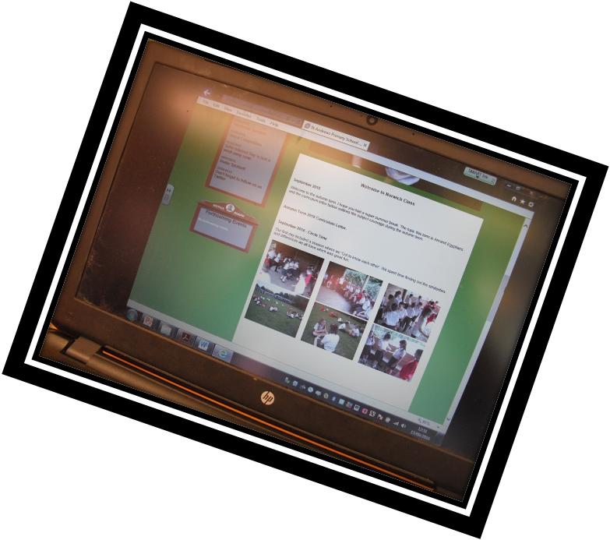
Class Web Page
Find out what’s happening in Y4

Slide 22

Questions
If you have any questions regarding this presentation, please do contact me and I will get back in touch as soon as possible.
Please be aware, further information regarding Christmas and school trips will be shared in due course.

Slide 23
Good Evening

