Slide 1
Reading at St Andrew’s
‘To develop a life-long love of reading’
Learn to read
1
Read for purpose
2
Read for pleasure
3

Slide 2
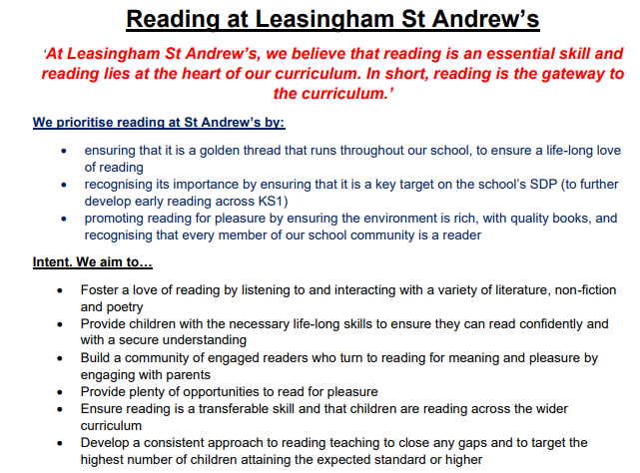
Vision
Golden Thread Running Through Curriculum

Slide 3
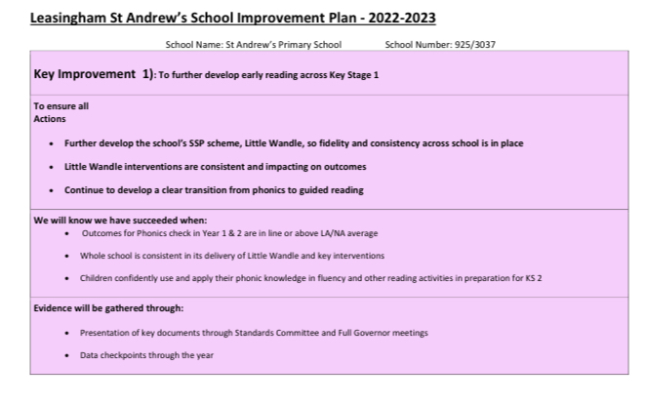
SDP Priority
Reading for pleasure and purpose is woven into school’s foundation subject action plans.

Slide 4
Ofsted

Slide 5
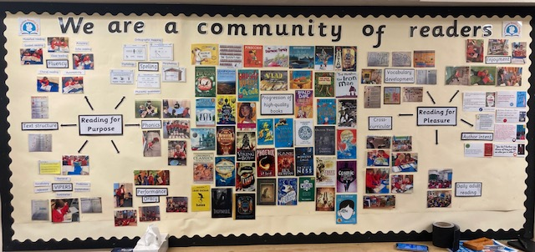
Reading Community
Everyone understands it importance
Reading culture
3 strands: learning to read, reading for purpose, reading for pleasure
Rich diet of diverse texts across cultures/ reading spine
Environment/ reading corners
Author engagement

Slide 6
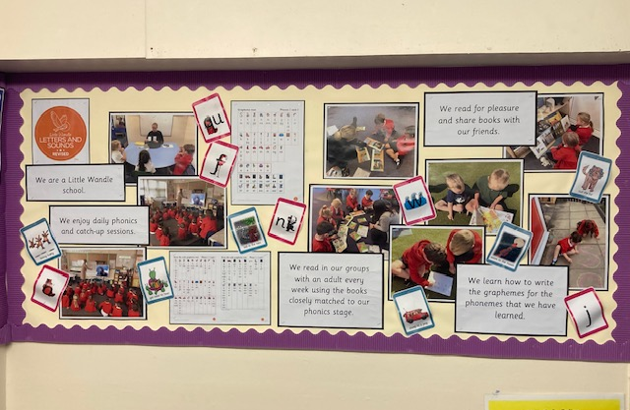
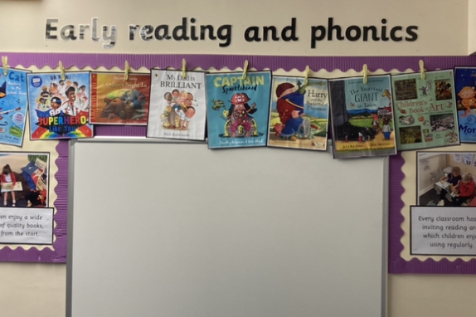
Environment
Early Reading/ learning to read

Slide 7
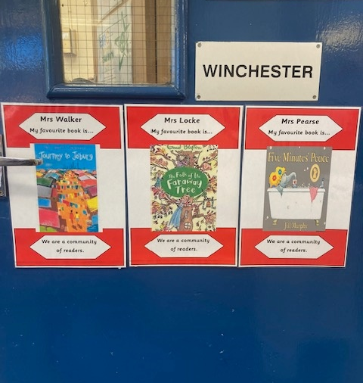
Community of readers

Slide 8
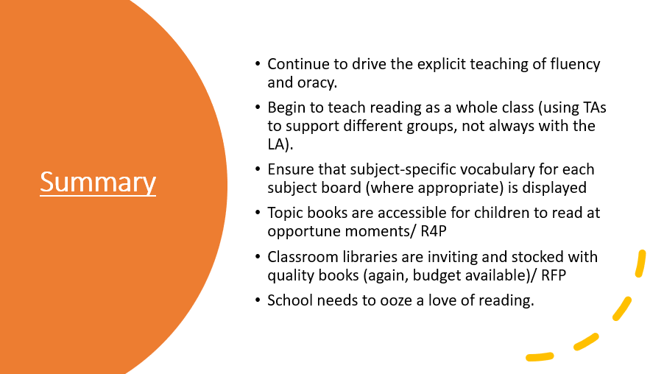
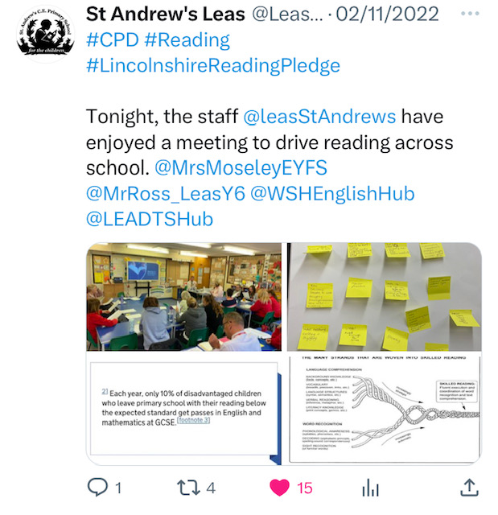
Professional Development

Slide 9
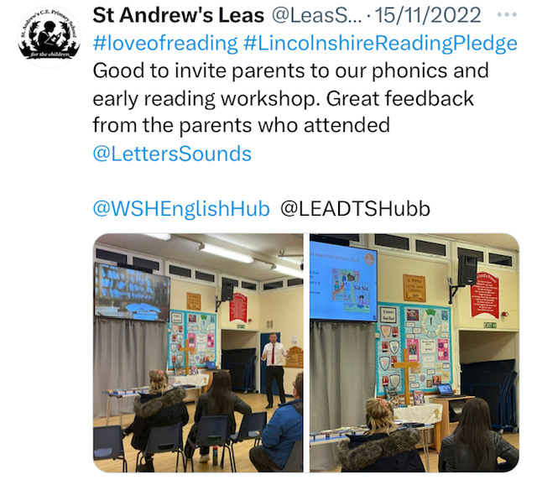
Parental Engagement

Slide 10
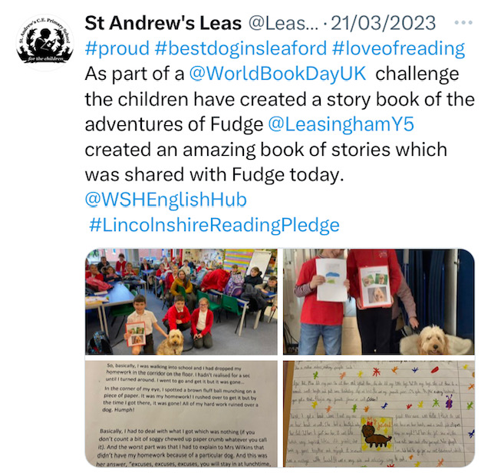
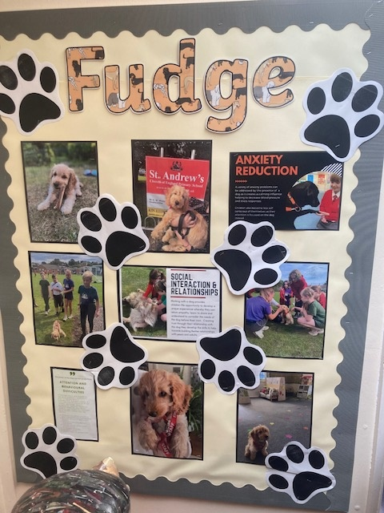
Fudge the school reading dog

Slide 11
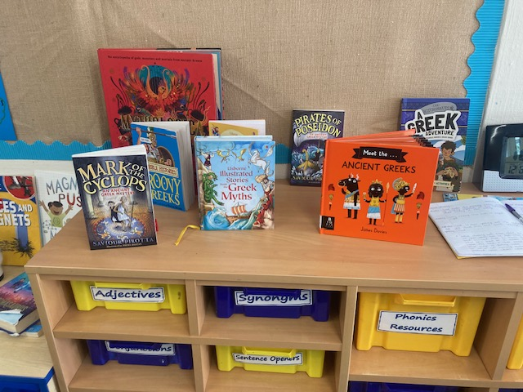
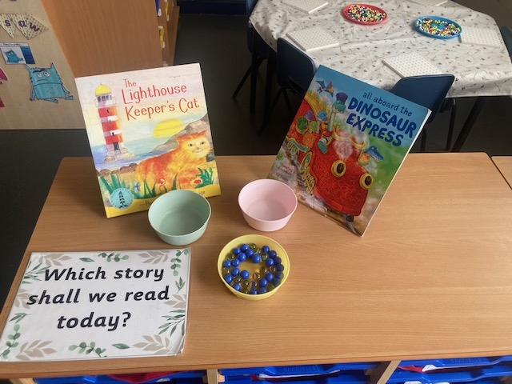
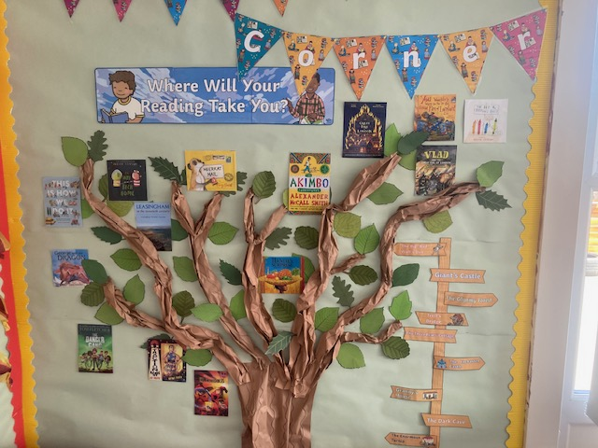
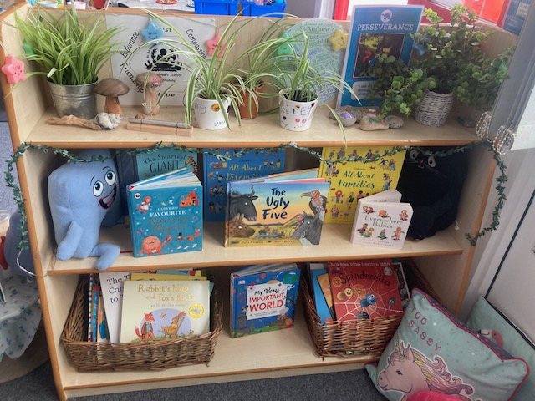
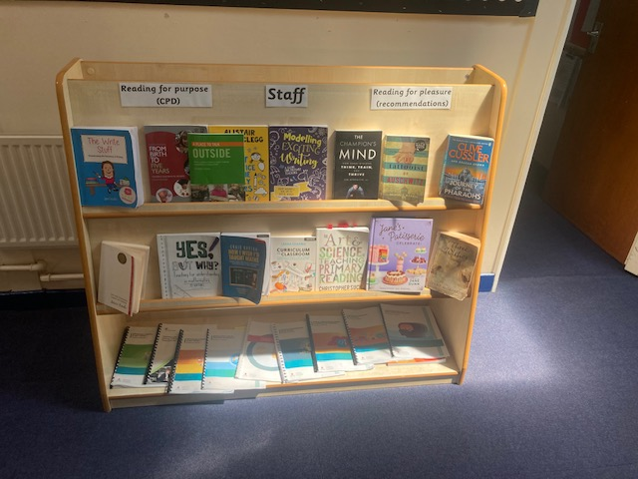

Slide 12
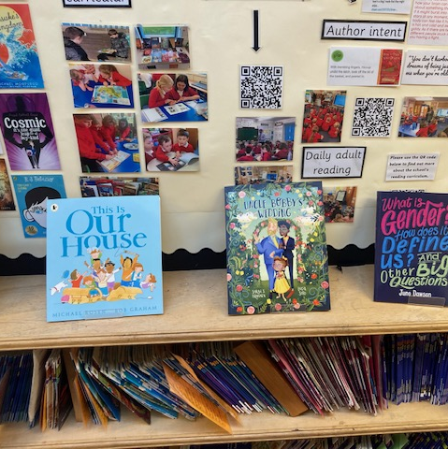
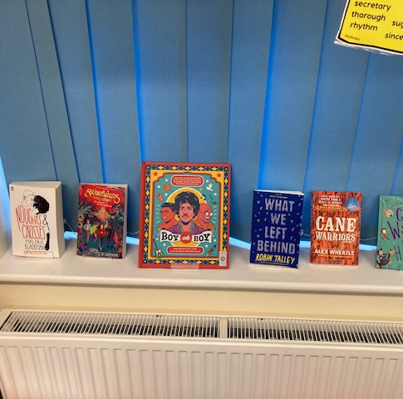
Suggested Reads/RfP

Slide 13
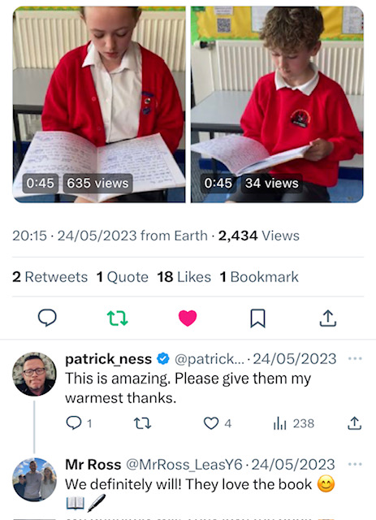
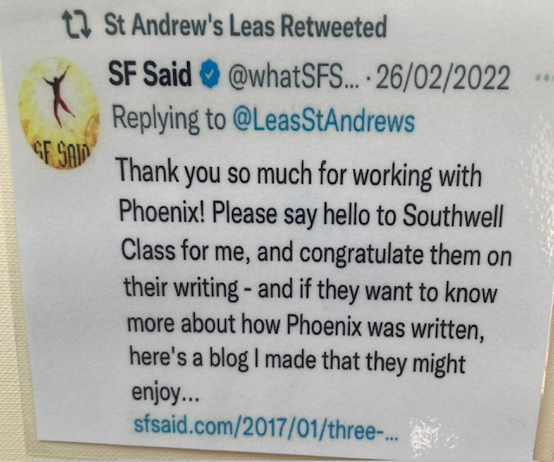
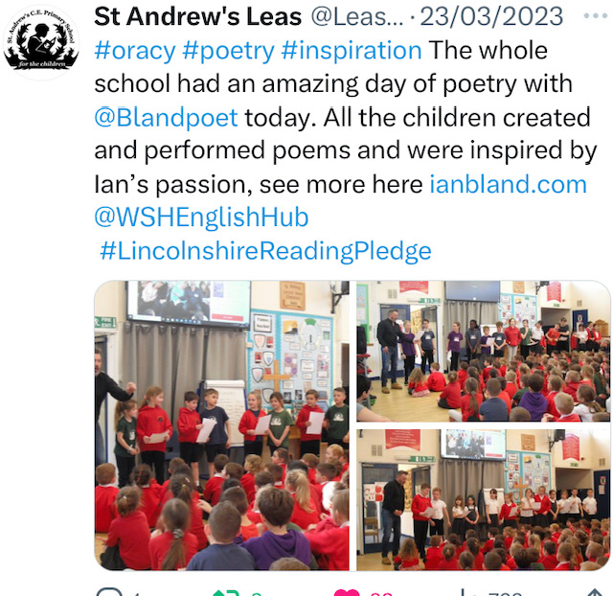
Author Engagement

Slide 14
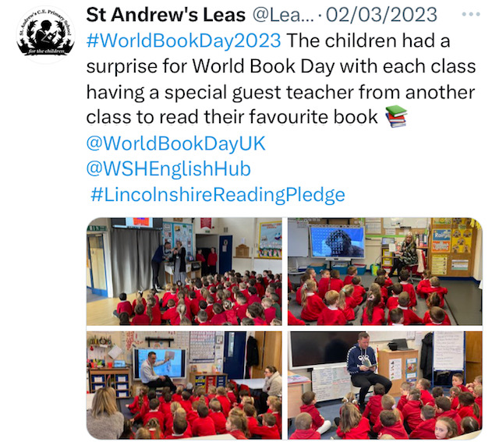
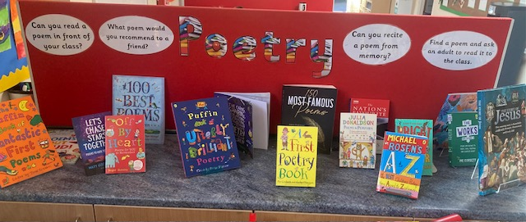
World Book and Poetry Day

